Slide 1
Introduction to React-Bootstrap

Slide 2
Objectives
What is React-Bootstrap?
Why use React-Bootstrap?
Features and aspects of React-Bootstrap
Installation and Configuration of React-Bootstrap
Grid, Layout of React-Bootstrap
Basic Components of React-Bootstrap: Button, Checkbox, Radios, Navigation(Navbars, Navs, Tabs), Modal, Alert, Card, Form controls…

Slide 3
What is React-Bootstrap?
React-Bootstrap is a popular open-source library that provides a set of Bootstrap components as reusable React components.
It combines the flexibility and power of the Bootstrap framework with the dynamic nature of React
Making it easier for developers to build responsive and feature-rich web applications with a modern design.

Slide 4
Why use React-Bootstrap?
React-Bootstrap is a complete re-implementation of the Bootstrap components using React.
It has no dependency on either bootstrap.js or jQuery.
React-Bootstrap provides a more reliable solution by incorporating Bootstrap functionality into React's virtual DOM.

Slide 5
Features and aspects of React-Bootstrap
Component-Based
Responsive Design
Easy Customization
Integration with React
Rich Component Library
Community and Support
Consistent Design
Faster Development
Cross-Browser Compatibility
Updates and Maintenance

Slide 6
Installation and Configuration of React-Bootstrap
Installation:
npm install react-bootstrap bootstrap
Import Bootstrap CSS:
import 'bootstrap/dist/css/bootstrap.min.css’;
Importing Components:
import Button from 'react-bootstrap/Button’;
// or less ideally
import { Button } from 'react-bootstrap’;
Use React-Bootstrap Components:
<Button as="a" variant="primary"> Button as link </Button>

Slide 7
Grid System
Bootstrap’s grid system uses a series of containers, rows, and columns to layout and align content. It’s built with flexbox and is fully responsive.
import Container from 'react-bootstrap/Container';
import Row from 'react-bootstrap/Row';
import Col from 'react-bootstrap/Col';
function ContainerExample() {
return (
<Container>
<Row>
<Col>1 of 1</Col>
</Row>
</Container>
);
}
export default ContainerExample;
import Container from 'react-bootstrap/Container';
import Row from 'react-bootstrap/Row';
import Col from 'react-bootstrap/Col';
function ContainerFluidExample() {
return (
<Container fluid>
<Row>
<Col>1 of 1</Col>
</Row>
</Container>
);
}
export default ContainerFluidExample;

Slide 8
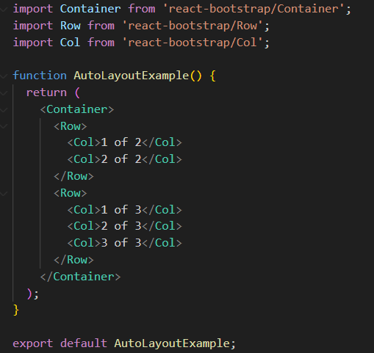
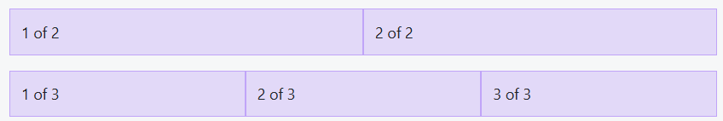
Auto-layout columns
When no column widths are specified the Col component will render equal width columns

Slide 9
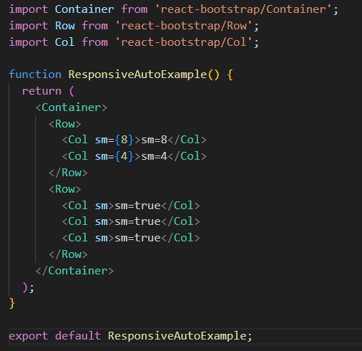
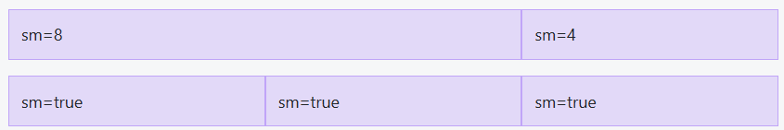
Responsive grids
The Col lets you specify column widths across 6 breakpoint sizes (xs, sm, md, lg, xl and xxl).
For every breakpoint, you can specify the amount of columns to span, or set the prop to <Col lg={true} /> for auto layout widths.

Slide 10
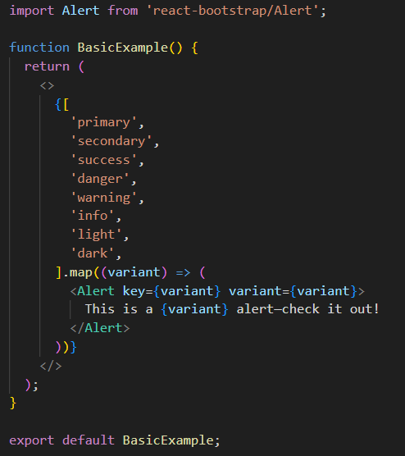
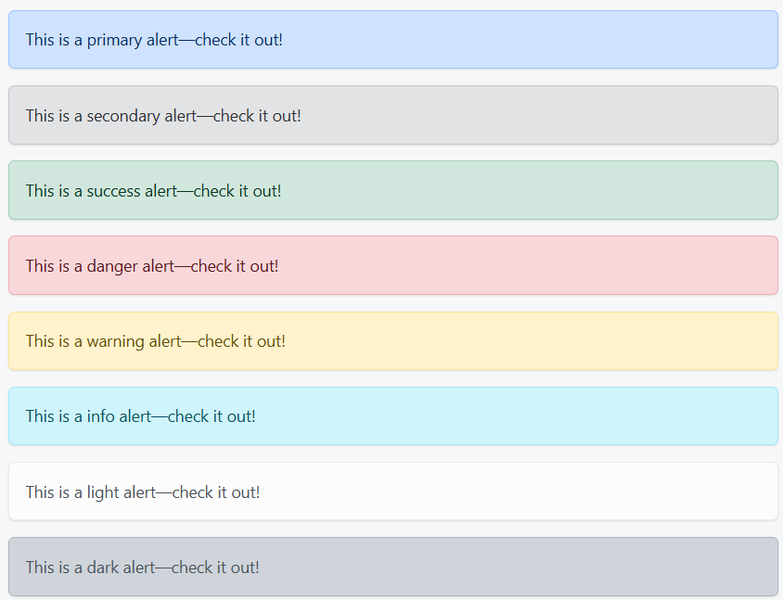
Alerts
Provide contextual feedback messages for typical user actions with the handful of available and flexible alert messages.

Slide 11
Buttons
Use Bootstrap’s custom button styles for actions in forms, dialogs, and more with support for multiple sizes, states, and more.
Use any of the available button style types to quickly create a styled button. Just modify the variant prop.
function TypesExample() {
return (
<>
<Button variant="primary">Primary</Button>{' '}
<Button variant="secondary">Secondary</Button>{' '}
<Button variant="success">Success</Button>{' '}
<Button variant="warning">Warning</Button>{' '}
<Button variant="danger">Danger</Button>{' '}
<Button variant="info">Info</Button>{' '}
<Button variant="light">Light</Button>{' '}
<Button variant="dark">Dark</Button>
<Button variant="link">Link</Button>
</>
);
}
export default TypesExample;

Slide 12
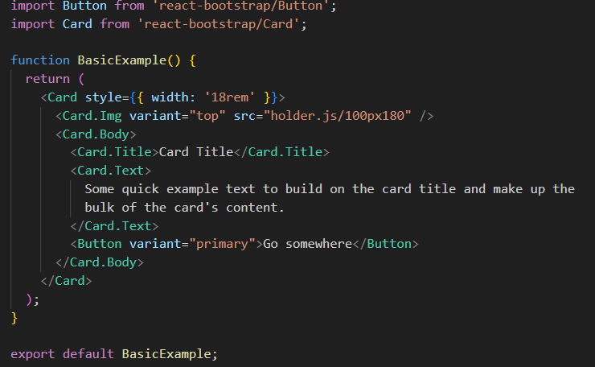
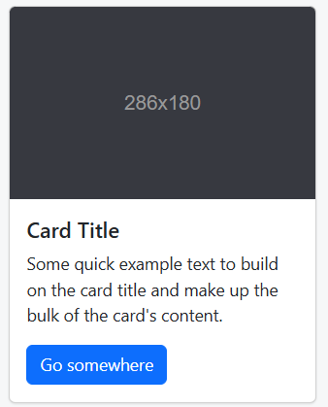
Cards
Bootstrap’s cards provide a flexible and extensible content container with multiple variants and options.

Slide 13
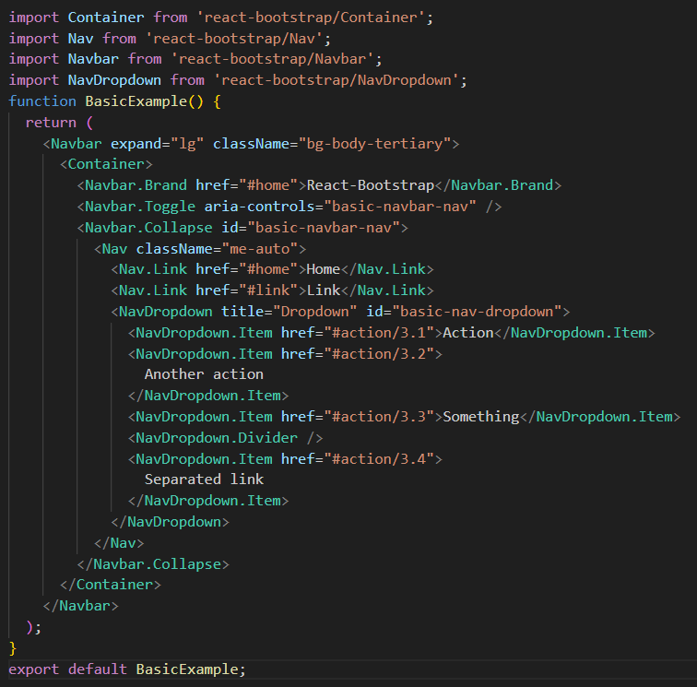
Navbars
A powerful, responsive navigation header, the navbar. Includes support for branding, navigation, and more.

Slide 14
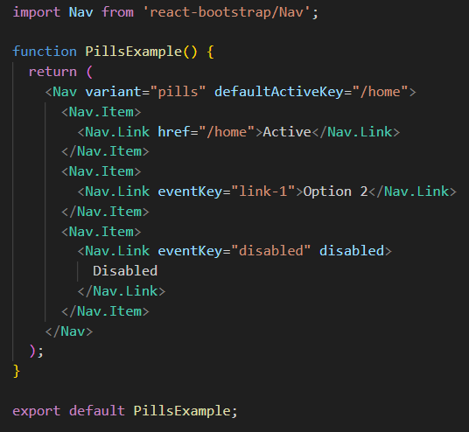
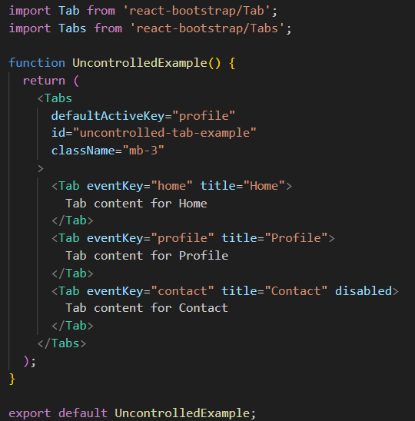

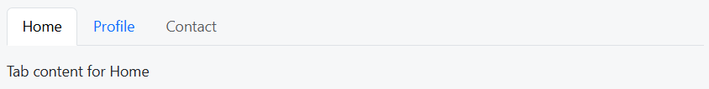
Navs and tabs

Slide 15
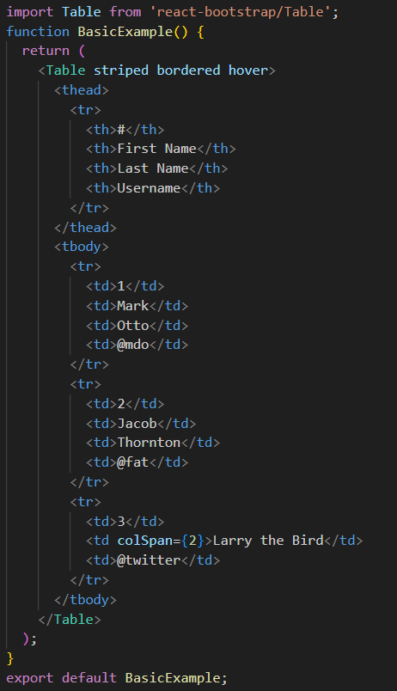
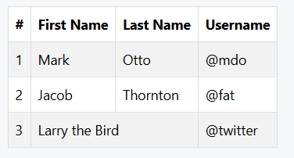
Tables

Slide 16
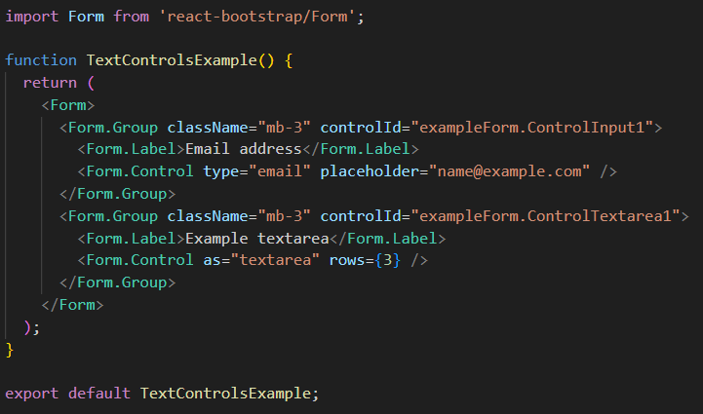
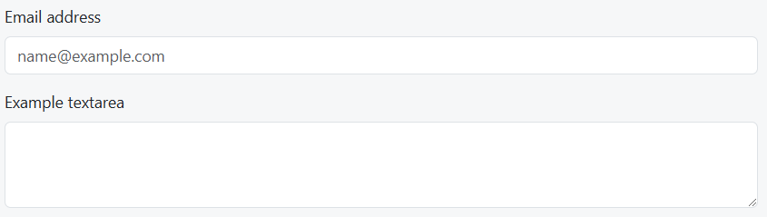
Form controls
Give textual form controls like <input>s and <textarea>s an upgrade with custom styles, sizing, focus states, and more.

Slide 17
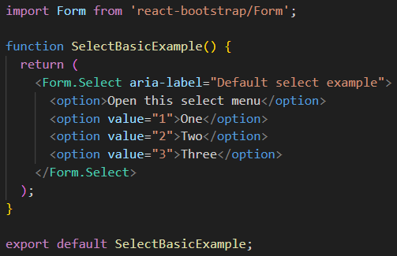
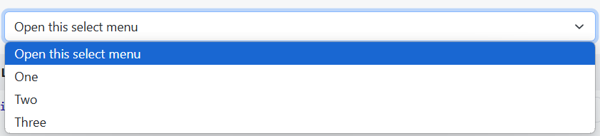
Select
Customize the native <select> with custom CSS that changes the element’s initial appearance.

Slide 18
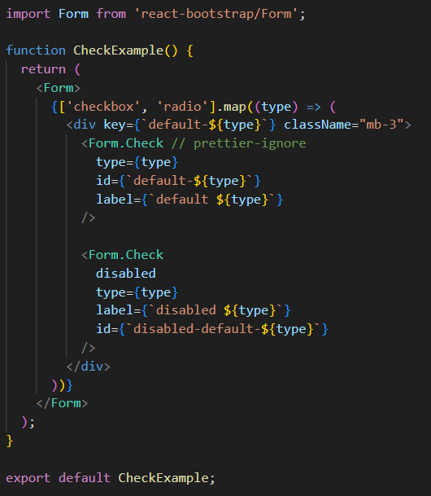
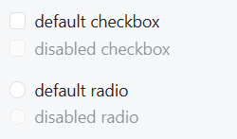
Checks and radios
Create consistent cross-browser and cross-device checkboxes and radios with our completely rewritten checks component.

Slide 19
Summary
Concepts were introduced:
What is React-Bootstrap?
Why use React-Bootstrap?
Features and aspects of React-Bootstrap
Installation and Configuration of React-Bootstrap
Grid, Layout of React-Bootstrap
Basic Components of React-Bootstrap: Button, Checkbox, Radios, Navigation(Navbars, Navs, Tabs), Modal, Alert, Card, Form controls…

